Slide 1

APPLICATIONS OF NLP IN SEARCH ENGINES
Search engines have come a long way since their inception. Today, we leverage the immense power of AI and NLP to make our search queries more accurate and relevant. Let's explore how NLP has transformed search engines, and the benefits it provides users.
Group No.10
Varnika Mulay 28
Aryaa Deshmukh 33
Aditya Krishna 41
Tanish Dhar 44

Slide 2

The Power of NLP in Search Engines
1
Parsing Natural Language
2
Contextualizing Search Results
NLP helps computers understand human language so that search engines can interpret queries more accurately.
NLP can help search engines understand the context of a search, providing more relevant search results.
3
Creating Personalized Results
4
Revolutionizing the Search Experience
NLP helps search engines learn user preferences so that it can personalize results based on the user's search history and behaviors.
NLP is revolutionizing the search experience, enabling users to search in a more natural and conversational way.

Slide 3
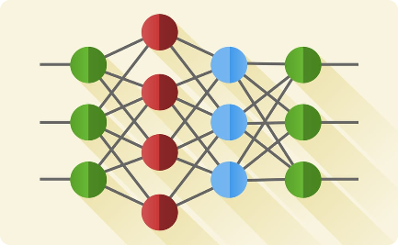


AI Integration and Optimization with NLP
Machine Learning
Voice Assistants
Search Engine Optimization
NLP can use machine learning to improve search results based on user interactions with search engines.
Voice assistant search engines are powered by NLP, which allows them to understand natural, conversational language.
NLP is making SEO more targeted and personalized, improving search accuracy and reducing irrelevant results.

Slide 4
Benefits of Integrating AI with Search Engines
1
Efficient and Accurate
NLP-powered search engines can save users time and increase accuracy of search results.
Personalized to Your Needs
2
Search engines can use AI and NLP to provide personalized search results based on user search history and behaviors.
3
Improved User Experience
NLP-powered search engines provide a more natural and intuitive search experience, making search less overwhelming and more enjoyable.

Slide 5
Challenges of AI Integration with Search Engines using NLP
Data Privacy and Security Concerns
Content Censorship and Bias
Unemployment and Socioeconomic Inequality
AI searches collect vast amounts of personal data, raising privacy and security concerns.
There is a risk of AI-powered search engines being used to censor content, or perpetuating bias in search results.
The use of AI in search engines may lead to job displacement and worsen socioeconomic inequality, which is already a challenging problem in our world.

Slide 6
Ethical Considerations in AI-Powered Search Engines
1
Transparency and Explainability
AI-powered search engines should be transparent and explainable, so users know how results are generated, and any biases or assumptions that drive these results.
Accountability and Responsibility
2
Organizations must be accountable and responsible for the use of AI in search engines, particularly when it comes to matters that affect privacy and data security.
3
Cultural Sensitivity and Diversity
AI-powered search engines should be sensitive to cultural diversity and avoid perpetuating and amplifying stereotypes and biases.

Slide 7



The Future of AI-Powered Search Engines using NLP
Greater Precision and Accuracy
Improved Voice Assistant Capabilities
Enhanced Multilingual Capabilities
As AI and NLP technology advances, search engines will become more precise in interpreting natural language, leading to more accurate search results.
Voice assistant search engines will continue to improve in understanding and responding to natural language queries, providing a more conversational and human-like search experience.
AI-powered search engines will become more adept at handling multiple languages, catering to a diverse global audience.

Slide 8

Conclusion
As the world becomes increasingly digital, AI-powered search engines using NLP will become the new norm. But it is up to us to ensure that these advances are used responsibly and ethically, to build a better world.

